Slide 1
‘REACHING THE UNREACHED’ PART I
by
Dr. Mrs. Philomena Kanagaraj

Slide 2
What is Evangelism ?
‘Evangelism is a necessity in helping men and women unerstand what their souls are searching for, can be met only through a personal relationship with Jesus Christ.” Dr. Selwyn Hughes
Evangelism is : ‘The winning of people out of the world to God through Jesus Christ and, incorporating them into local bodies where they grow inintimacy with God and participate in the extension of His Kingdom.’
‘The amount of information is directly proportionate to the person’s readiness for the Gospel’ Dr. Paul Gupta
‘The methods may change but the message will never change, unto eternity’
Dr. Naomi Dowdy
‘EVANGLION’ in Greek : The Gospel
‘EUANGELION’ in Latin : The Good News

Slide 3
The Goal of the Counseling
The Goal of the counseling being that the counselee goes through the process of realizing the cause of his predicament or problem, asks God’s forgiveness and, moves on to a healthier holier and spiritually strong Christian life and future.
Our goal is not just solving the ……..present problem but, discovering and eliminating the cause and, teaching them skills so they do not need our assistance, and helping them develop an ongoing program …….. .
The spiritual life of the individual ……. is both part of the healing process and a major developmental goal of counselling.
Wright H. Norman, ‘A Christian Integrative Approach’ in Christian Marital Counselling - Eight Approaches to Help ing Couples’, edited by Worthington Jr. Everett L., Copyright (C)1996 by Baker Books, Baker Book House Grand Rapids, Michigan USA, First Indian edition 1999 , ISBN 81-7362-209-4. pg 189,191.

Slide 4
a christian counsellor
The Counsellor must believe in Christ, and in the Scriptures;
He/she must truly live a life in Christ, so that he/she can counsel the Counsellee in such a way, as to lead them through the process of repentance and re-dedication to Christ ;
He/she must help them to love God with all their hearts, minds and souls and, lead them towards the goal of a Victorious, Spiritually Healthy Christian life.
+++++++

Slide 5
Christian Counselling - Definition
‘Christian Counselling is an approach, based on what God has said and what Christ and His apostles have experienced about human nature and the problems associated with it and, draws on the truths as revealed in the Bible by God, through His prophets and apostles.
Thus it can be seen that in this method of Christian Counselling, the perspectives are based on the biblical revelation which is the foundation and, on it are built various stages of Counselling methodology to deal with different areas of human psyche.
Alternately, Christian Counselling can also, be termed as Bible-based Counselling’ .
T.S. Kanagaraj , B.E.(Mech), M.B.A., M.Div., Christian Counsellor, Founder -Shantha C.Ramchander Charitable Trust.

Slide 6
Evangelism in Counselling
‘A CHRISTIAN COUNSELLOR’S WORK IS UNSEEN, BUT, HIGHLY POWERFUL AND AFFECTIVE IN GOD’S KINGDOM.
AS WE COUNSEL – THE DIRECTION AND PURPOSE OF THE COUNSELLEES’ LIVES TURN FOR THE BETTER AND, ULTIMATELY TURN TOWARDS ETERNITY, IN CHRIST.’
Dr. P. Kanagaraj

Slide 7
‘Christian Counselling’ as a ‘Tool for Evangelism’.
The ultimate goal of a Christian Counsellor is to Evangelize.
However, when the affected person is at his/her most vulnerable
point in their lives (either ill, bed-ridden or in conflict/ problem)
they should not be talked into the decision to follow Christ.
Evangelizing the Gospel at all times, is imperative. One has to
respect their privacy of suffering, before they are led to Christ in
a gentle manner.
If decisions are forced upon them, at such times, chances of such
people backsliding, into their former religious beliefs or habits,
later on, are high.

Slide 8
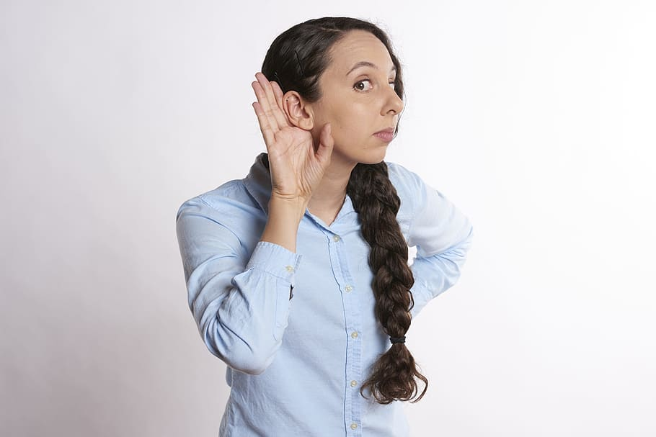
GOOD LISTENER !

Slide 9
LISTENING SKILLS
We do not listen to understand, but we listen to reply !
Most essential skill of a Counsellor is LISTENING
75% of Counselling is Listening …
Hearing is to gain information for oneself
LISTENING is to hear beyond what the other person is trying to communicate …..
LISTEN with your heart ….
Be empathetic ….
Lots of patience to keep pace with counsellee

Slide 10
LEARNING TO LISTEN
LEARNING TO LISTEN IS A CRUCIAL PART OF COUNSELING.
THERE IS DIFFERENCE BETWEEN HEARING AND LISTENING.
HEARING IS THE GAINING OF INFORMATION FOR ONESELF.
LISTENING IS CARING FOR AND BEING EMPATHETIC TOWARD OTHERS.....
WHEN TO SPEAK AND WHEN NOT TO SPEAK
Pro 10:19 – “Don’t talk so much. You keep putting your foot in your mouth. Be sensible and turn off the flow. (Living Bible)
Pro. 17:27 – A man of knowledge uses words with restraint, and a man of understanding is even-tempered.
Pr. 12:25 – “Anxiety in a man’s heart weighs it down, but an encouraging word makes it glad”

Slide 11
Communication and Communication Styles
Communication is a two-way process.
TRANSMISSION OF MESSAGE
SENDER } {
or } MEDIA CHANNEL { RECEIVER
} {
COMMUNI- } {
CATOR} }
FEED BACK
Communication is therefore a two-way Process:
“Communication is a Process (a Transaction) wherein messages between a Sender
and a Receiver are transmitted through a MEDIA with a Feed-back.” Dr. George Ninan

Slide 12
BARRIERS TO COMMUNICATION
Noise Transmission of Message Noise
Language /
Attitudes /
Childhood
Upbringing /
SENDER } CHANNEL/ Knowledge / CHANNEL/ { RECEIVER
or } or MEDIA Culture / or MEDIA { or
SPEAKER } Prejudices / {LISTENER
Perceptions /
Memories /
Education
FEEDBACK
Noise Barrier Barrier Noise

Slide 13

Perceptions

Slide 14
AMBASSADORS FOR CHRIST II Cor. 5:19-20
19 And He has committed to us the message of reconciliation [that is, restoration to favor with God].
20 So we are ambassadors for Christ, as though God were making His appeal through us; we [as Christ’s representatives] plead with you on behalf of Christ to be reconciled to God.

Slide 15
THANK YOU !

